Slide 1

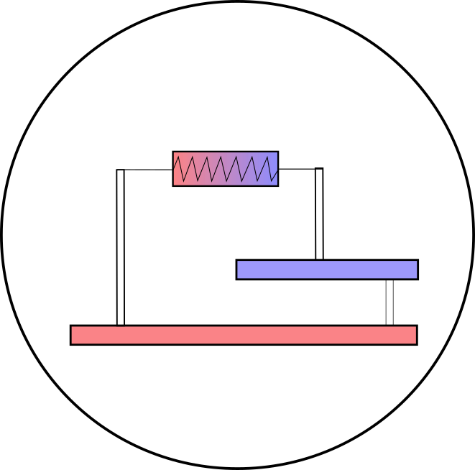


Investigating geothermal heat resources of legacy mine workings: Why are some mine waters hotter than others?
Mylene Receveur
Christopher McDermott, Stuart Gilfillan, Andrew Fraser-Harris, Ian Watson
Notes:
I am going to talk about geothermal energy, and more specifically about the low temperature resources that we can find in abandoned flooded mines. There is a growing interest in using geothermal from mines, Geothermal is not only steaming ground, but it can be found everywhere, even in mines, But mines are more complex than conventional sedimentary geothermal reservoirs, My researches focus in understanding the temperature distribution in coal mines in the UK, the sources of heat and recharge mechanisms to evaluate their geothermal potential.

Slide 2
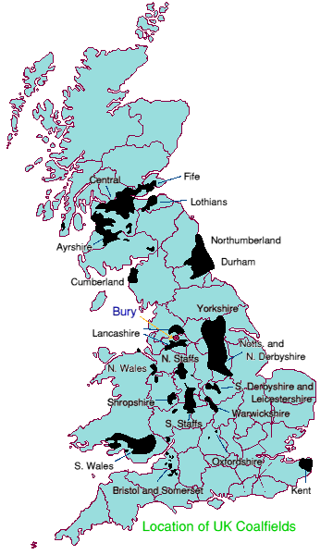
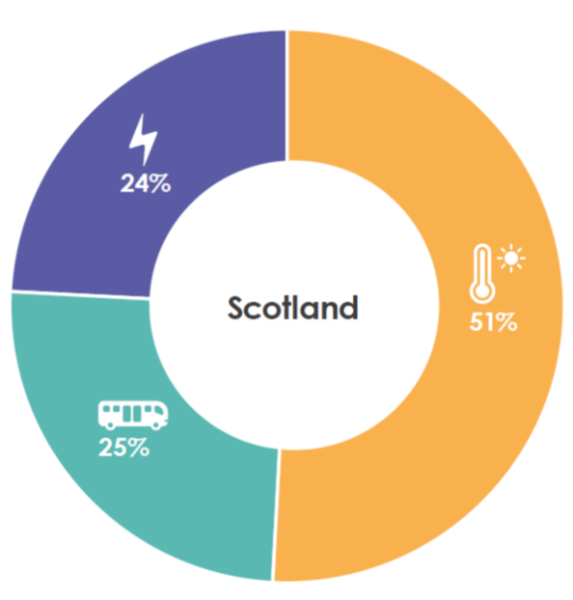
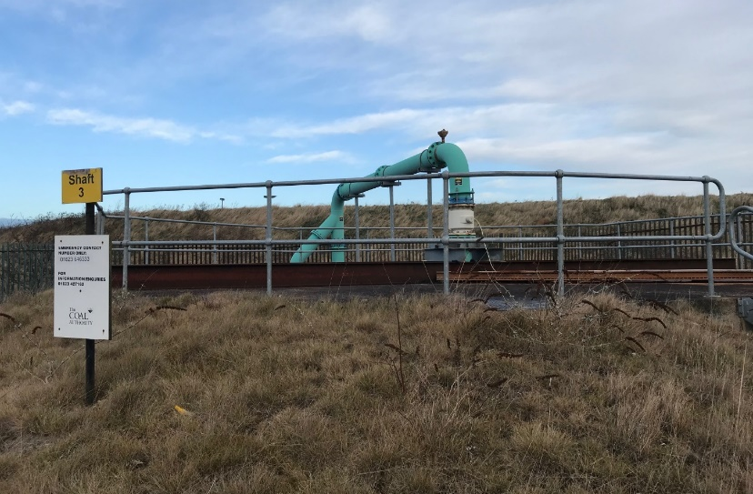
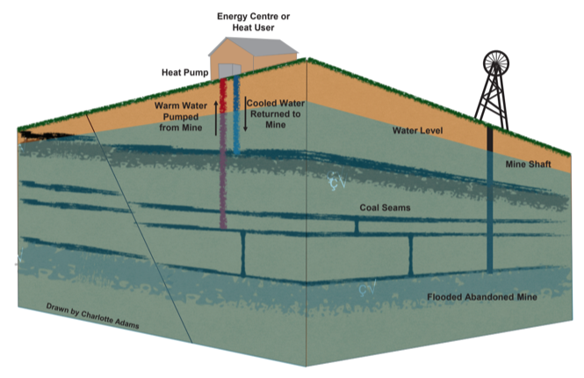
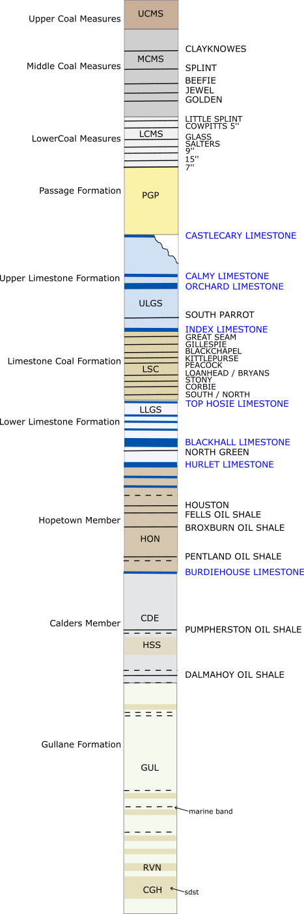
Introduction
Chapter 2
Chapter 3
Chapter 1
Methods
Conclusion
BACKGROUND
Minewater heat: a new local energy source to reach decarbonization targets
Mine-water heat: 7% of Scotland’s heat demand (Todd et al., 2019)
Schematic diagram of a mine water heat pump system (Adams et al. 2019)
Notes:
Why is it important? Minewater geothermal has massive potential:
Co-location with population density : Most of the UK and Scotland have underground coal workings (9% of UK population located above abandonned coal mines)
Potential for regeneration of mining communities
Now all abandoned and flooded as pumping ceased → Existing 12-20 °C resource at 200-800m depth
Making use of existing mine legacy (and potential liability for the CA) = Mine closed but could still be mined for heat, as flooded, and pumping already implemented (Coal Authority)
Coal authority interest – finance pumping fees they are responsible for (avoid mine-water surface contamination)
How much primary energy usage goes to heating in the UK = 50 %
Fiona estimated that this warm water could provide 7% of UK requirement of heat → could participate to the UK target to decarbonizing heat and meet the 2024 requirement
A few case studies of GSHP on coal mines already exist worldwide, including 2 implemented systems in the UK and Scotland.
- At Heerlen, abandoned mines are used to deliver space heating and cooling to around 200,000 m2 of mixed use new and retrofit buildings via a 7-km-long heat network
- In Shettleston, where at least 6 seams have been mined, the water is heated to 55°C through a heat exchanger, to provide heat to 16 dwellings.
- In Lumphinnans, at least 11 seams belonging to the Lower Carboniferous Limestone Coal Group have been mined (including the uppermost Lochgelly Black Band Ironstone, the Seven Foot Seam, the Kelty Main, the Jersey or Diamond Seam and the Swallowdrum (Burke 1999)).
How does this work? Open-loop GSHP systems - Can be used for space / hot water heating
Warm water can be extracted at high rates from enhanced-permeability reservoirs because large voids.
In the UK, those voids (mine shafts, tunnels, workings) are in the coal measures (shallow early mining) and down to 800 m depth (LCR, deep mining)
GSHP used to extract heat from the ground or from the water using open-loop systems.
Injection/production of cold/hot water can be reversed seasonally. Proven to increase the system lifetime.
Extracting water can induce inflow of recharge water (from infiltration, lateral aquifers), or re-injection can be performed. → Need to know how fast heat is recharged

Slide 3
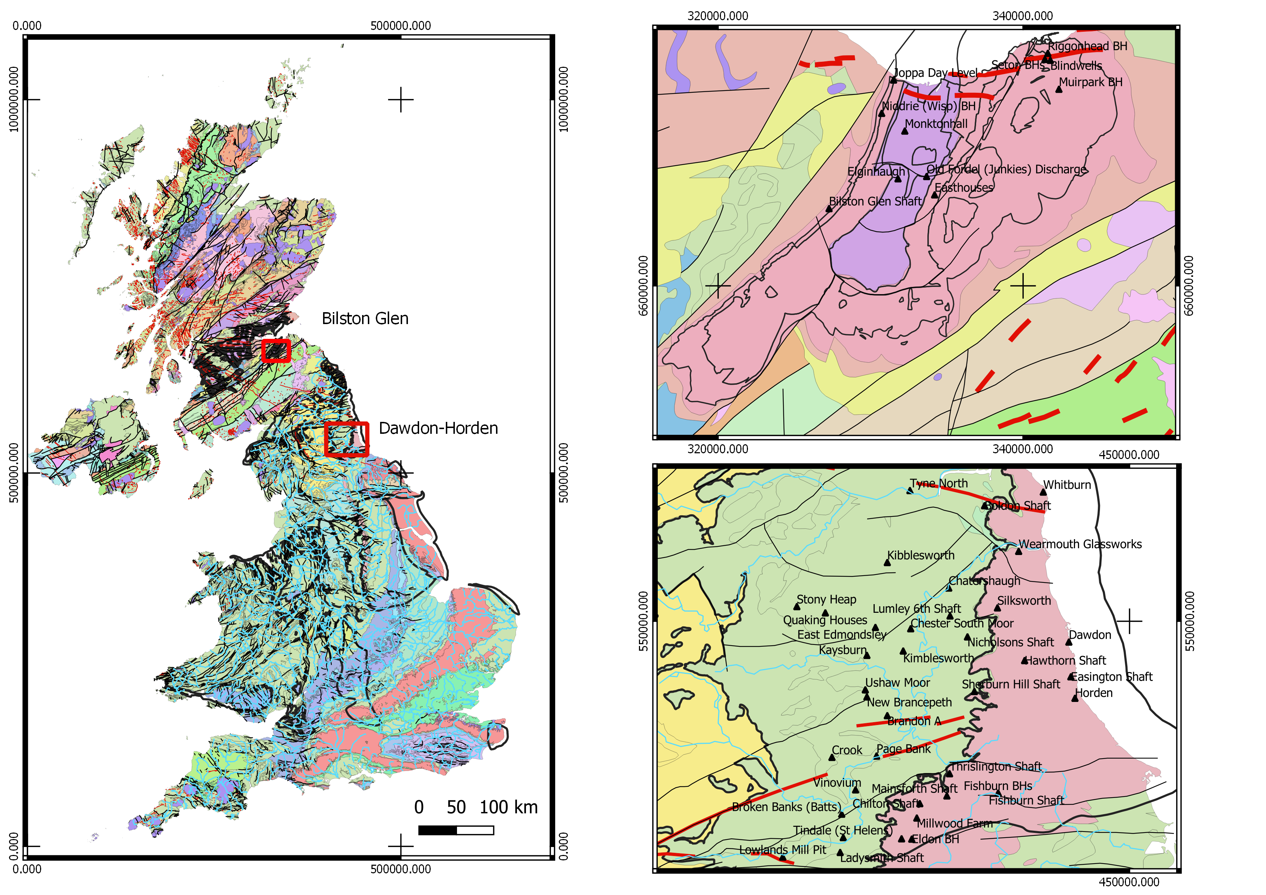
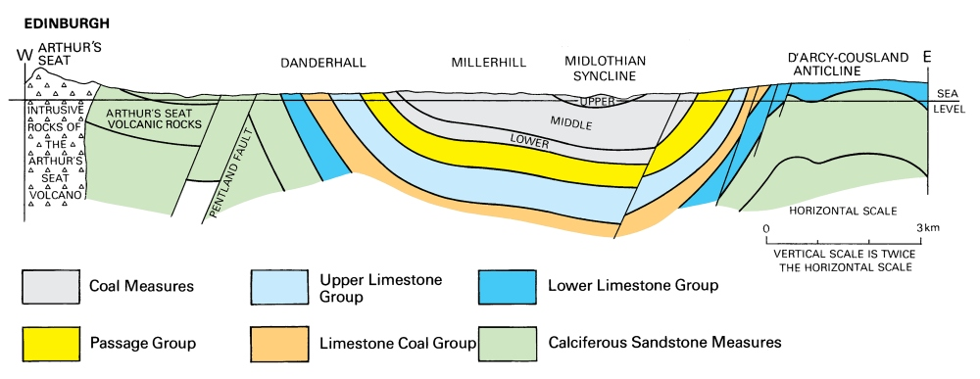
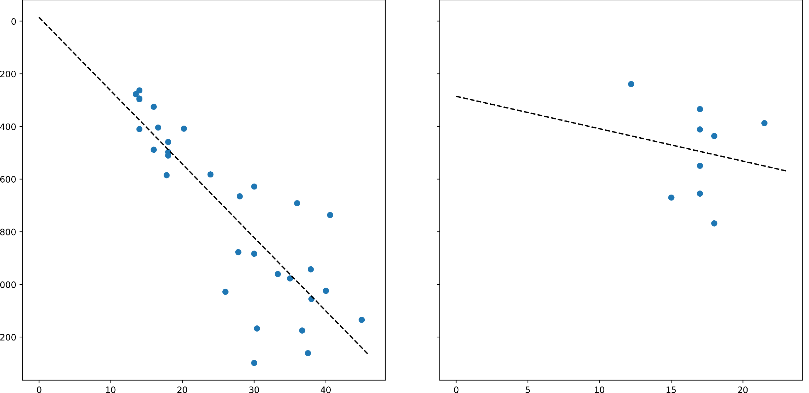
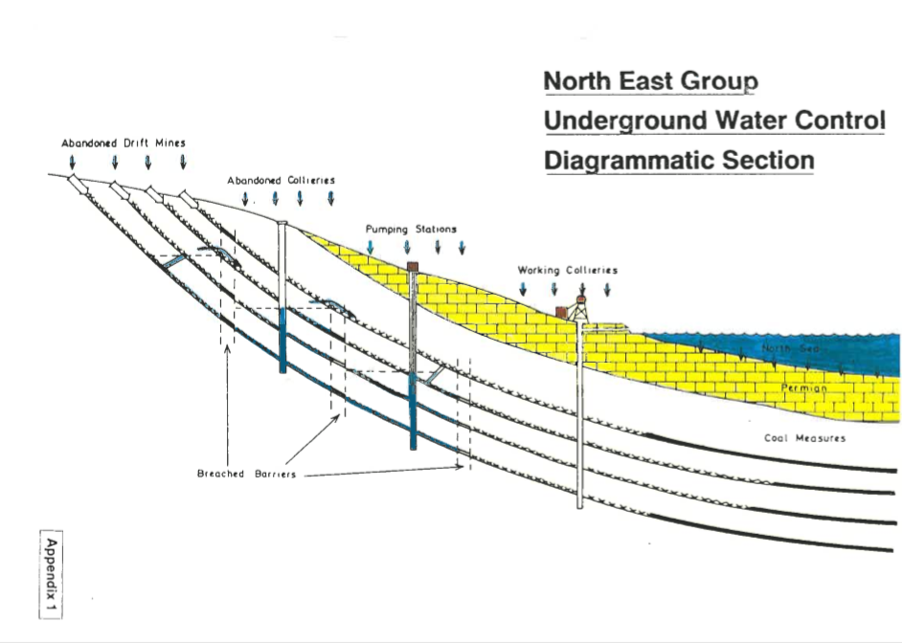
Introduction
Chapter 2
Chapter 3
Chapter 1
Methods
Conclusion
RESEARCH QUESTIONS
Bottom Hole temperature Mine-water temperature
T= 8 + 0.03 z
Depth
Temperature Temperature
Why do different mines have different temperatures?
RQ1 - What are the key heat recharge mechanisms and heat sources controlling the water temperature in flooded coal mines
RQ2 - What is the impact of past mining activities on the thermal state and temperature distribution in mines?
RQ3 - What are the key mine features impacting the heat exchange rate at the scale of a mine?
Notes:
However, a recent study showed that there is no clear correlation between temperature and depth, in the measurements taken in shafts and boreholes of several mines.
So the temperature in mines does not only depends on the geothermal gradient,
However, it is essential to understand from where the heat comes from to estimate the long-term potential and suitability of heat production from coal mine = how fast will the heat be replenished = need to get a better understanding of the source of heat and recharge mechanisms,
The research will involve numerical modelling of mines, calibrated and validated using real data from 2 different areas:
- Bilston Glen in Scotland
- Dawdon in NE England
Objective 1:
create hydrological/thermal conceptual model(s) of flooded coal mines to identify the main controls on mines temperatures.
develop a numerical approaches able to discriminate between the contribution from different types of heat fluxes induced by heat extraction and heat/water recovery
Objective 2:
determine the thermal state of a mine after a period of mining and flooding.
assess the initial temperature distribution within a mine to evaluate its original heat potential
Objective 3:
assess the key features in mine plans having significant impact on the heat depletion and rate of energy recharge at the scale of a mine or network of interconnected mines
create representative but simplified model of mine workings will be developed in order to assess the potential of mines, in terms of energy storage/heat capacity.
define the extent of the area impacted by heat extraction around the production well, depending on the mine structure.
Limitation of data: not always information on the depth to the water level, depth of the logger or depth of the shaft

Slide 4
RQ1: What are the key heat recharge mechanisms and heat sources controlling the water temperature in flooded coal mines?
Introduction
Chapter 2
Chapter 3
Chapter 1
Methods
Conclusion
Methods:
Conceptual models
Numerical modelling: OpenGeosys
Sensitivity analysis
Methods:
Conceptual models
Numerical modelling: OpenGeosys
Sensitivity analysis
Questions:
What are the main heat sources in coal mines?
What are the main heat transfer processes?
Questions:
What are the main heat sources in coal mines?
What are the main heat transfer processes?
WHAT ?

Slide 5
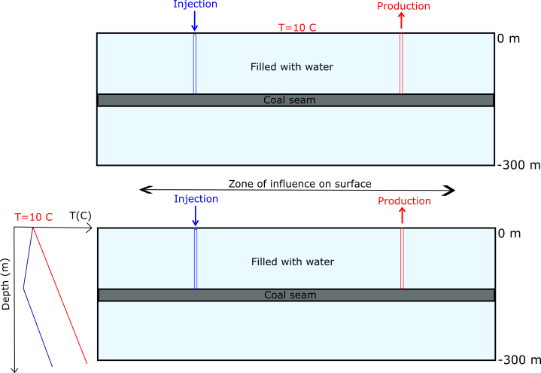
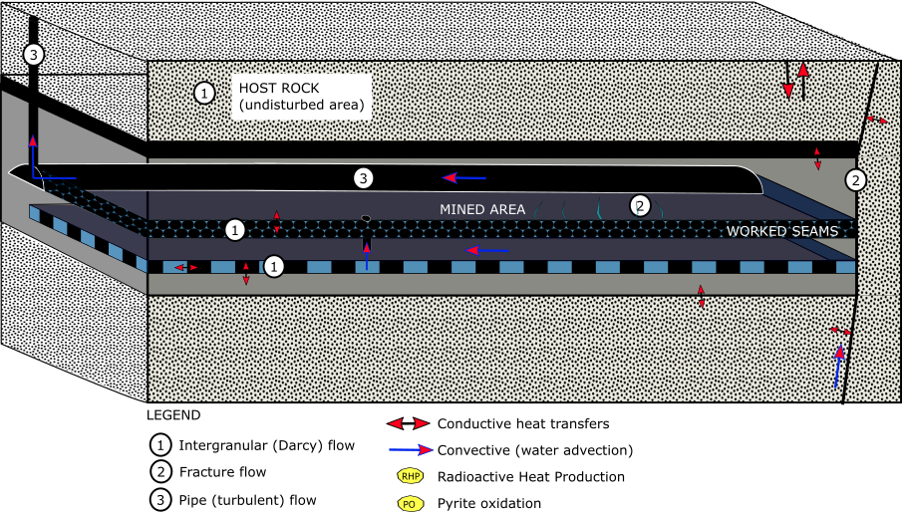
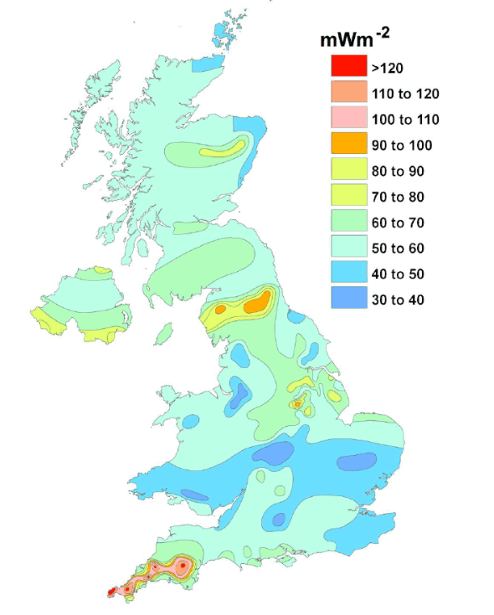
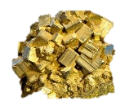
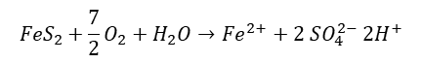
Conceptual models
Introduction
Chapter 2
Chapter 3
Chapter 1
Methods
Conclusion
Solar flux
Rainfall
$${FeS}_{2}+\frac{7}{2}O_{2}+H_{2}O→{Fe}^{2+}+2 {SO}_{4}^{2−} {2H}^{+}$$
Notes:
First step: create a conceptual model to identify the sources of heat and fluxes.
Complex geometry and mixed/interconnected processes → need to decompose the big heat transfer in mines problem in smaller, managable problems before attempting to solve them numerically and get an overall understanding on the processes,
This will allow to assess the contribution from different elements on the heat generation and renewal in mines, both through mathematical, analytical and numerical models::
This includes:
natural heat flow / geothermal gradient
Local heat generation : radiactive decay, pyrite oxidation
solar influx
Groundwater flow = convective flux: has been one of the main issue in former mine modeling = the actual origine of mine water = the boundary conditions →
Geological structure: geological formation with specific material, thermal and hydraulic properties; geological disturbances (i.e. faults)
Still uncertainties about the origin of recharge water (heat source or sink?): assess the heat exchange rate with surrounding rocks

Slide 6
RQ1: What are the key heat recharge mechanisms and heat sources controlling the water temperature in flooded coal mines?
Introduction
Chapter 2
Chapter 3
Chapter 1
Methods
Conclusion
Methods:
Conceptual models
1D/2D Numerical modelling: OpenGeosys
Methods:
Conceptual models
1D/2D Numerical modelling: OpenGeosys
Questions:
What are the main heat sources in coal mines?
What are the main heat transfer processes?
Questions:
What are the main heat sources in coal mines?
What are the main heat transfer processes?
HOW ?
Notes:
Once i know what produces heat, I need to know how they contribute to the heat recharge rate = what are the mechanisms and nature of the heat fluxes induced by production-
This implies understanding the heat fuxes, hence the second question
What is the water-rock heat exchange rate in mined areas (i.e. goaf) and tunnels, depending on:
The water source / temperature
The flow rate
The rock properties (i.e. permeability, thermal conductivity)
The flow path length

Slide 7
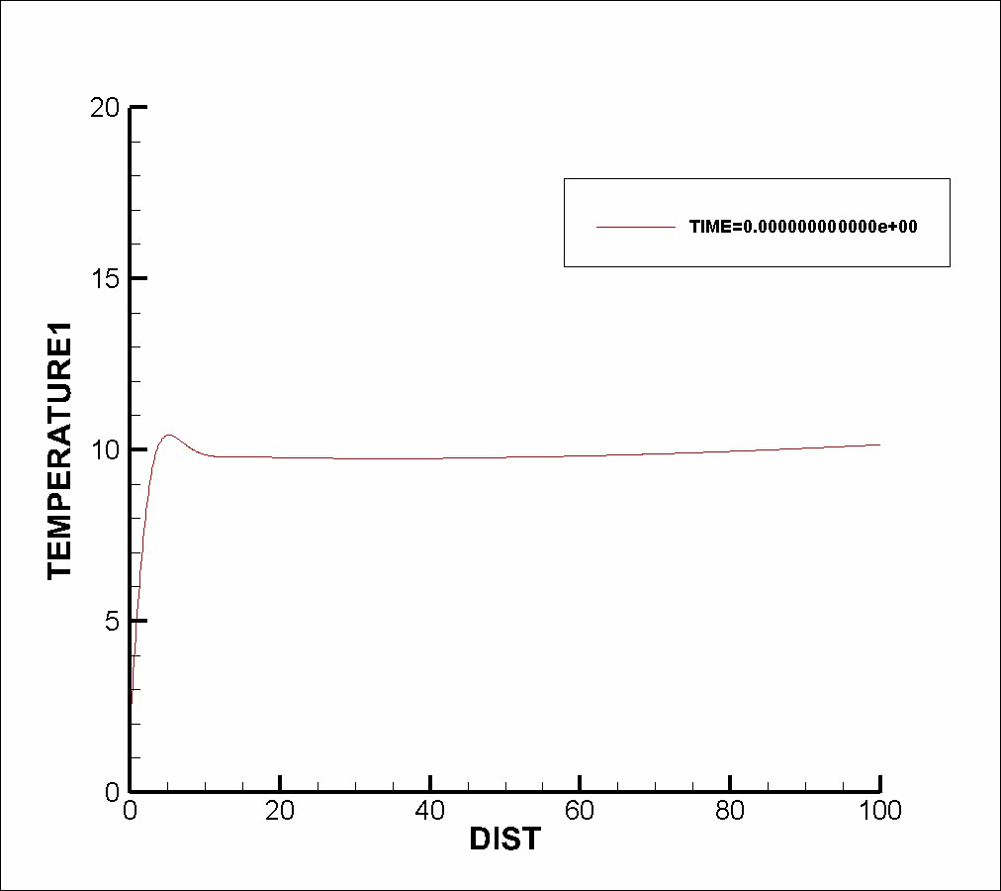
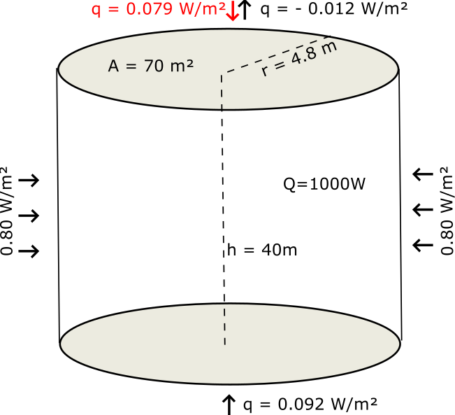
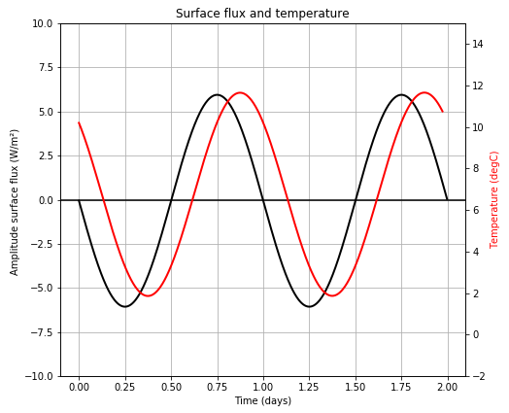
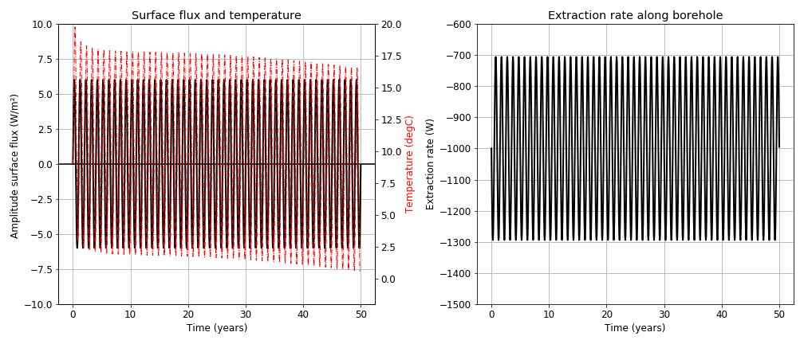
NUMERICAL APPROACH
Introduction
Chapter 2
Chapter 3
Chapter 1
Methods
Conclusion
Vertical conductive flux
H0 – Solar heat recharge is negligible relative to the geothermal heat flux.
1) What is ∆q ?
-1000W
Notes:
Need to speak in terms of flux
Most of previous studies considered fixed temperature at top BC but not correct for shallow systems
Sensitivity analysis on geometrical, technical or numerical parameters

Slide 8
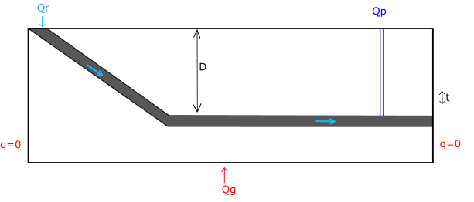
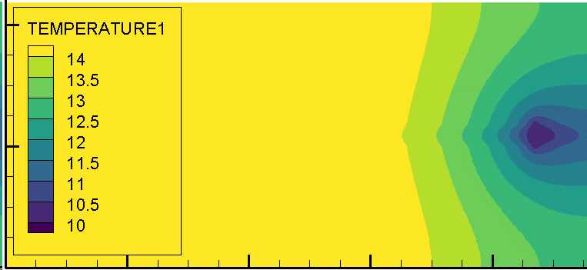
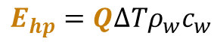
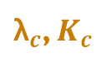
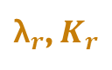

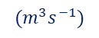

Next step: SENSITIVITY ANALYSIS
Introduction
Chapter 2
Chapter 3
Chapter 1
Methods
Conclusion
What if water flows ?
HOW ?
H1 – Heat advection is dominant in tunnels during production
& heat conduction is dominant in mine workings.
H2 – Vertical conductive recharge is dominant during recovery.
WHERE ?
WHEN ?
T°C ?
$$E_{hp}=Q∆Tρ_{w}c_{w}$$
$$Q_{r}$$
$$(m^{3}s^{−1})$$
h
${\text{λ}}_{r}$, $K_{r}$
T°C ?
$$Q_{r}$$
${\text{λ}}_{c}$, $K_{c}$
L
Extraction VS Recharge → Steady state ? Footprint area ?
Notes:
What is the nature of the fluxes when you extract hot water from mines ?
How does water advection impact the heat recharge rate in the system relative to conduction?
What is the rock-water heat exchange rate in mined areas (i.e. goaf) and tunnels/the temperature change within the system during production depending on:
The void type (geometry, volume of pores)
The rock properties (i.e. permeability, thermal conductivity)
The source/temperature of water
The path length
The flow rate (i.e. pumping and/or infiltration rate)
The volume of water extracted vs the energy extracted
contrasts in rock properties differes from conventional aquifer, where i.e. sandstone (porous/permeable) generally have higher conductivity and surrounding low-k low-K layer allow a slow recharge of the system
What is the footprint area of heat extraction? Can thermal steady state be reached?
How does water advection contribute to energy recharge relative to purely conductive situations ?
how much heat is required from advective heat transport to satisfy extraction and maintain sustainability?
Is the ratio of advective to diffusive heat transport required realistically achievable?
Are there any geologically realistic scenarios where these conditions are expected? (see Peclet number)
To do: try to calculate equivalent properties based on the weighted harmonic mean for the different hydraulic and thermal properties?
= Need to understand groundwater processes and how they superimpose onto conductive/undisturbed geothermal gradient in highly conductive layers → This leads to chapter 2 – as mines might not be at equilibrium / due to the past activities within the mine

Slide 9

RQ1: What are the key heat recharge mechanisms and heat sources controlling the water temperature in flooded coal mines?
Introduction
Chapter 2
Chapter 3
Chapter 1
Methods
Conclusion
Methods:
Conceptual models
1D/2D Numerical modelling: OpenGeosys
Questions:
What are the main heat sources in coal mines?
What are the main heat transfer processes?
WHAT ?
HOW ?
Output:
Analytical solutions for T°C(t) water during production
% vertical/lateral conductive/advective heat fluxes induced to satisfy demand
Graphs: Optimal production rate/recovery rate = f(L, α, λ, ρ, $v_{w}$, $T_{w})$
Notes:
Once i know what produces heat, I need to know how they contribute to the heat recharge rate = what are the mechanisms and nature of the heat fluxes induced by production-
This implies understanding the heat fuxes, hence the second question
What is the water-rock heat exchange rate in mined areas (i.e. goaf) and tunnels, depending on:
The water source / temperature
The flow rate
The rock properties (i.e. permeability, thermal conductivity)
The flow path length

Slide 10
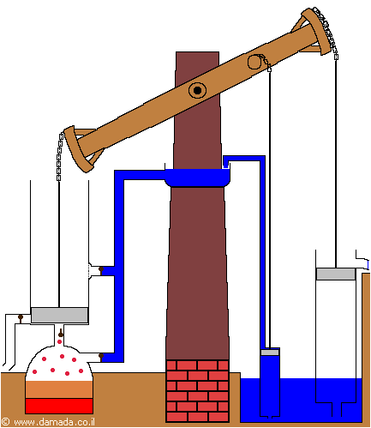
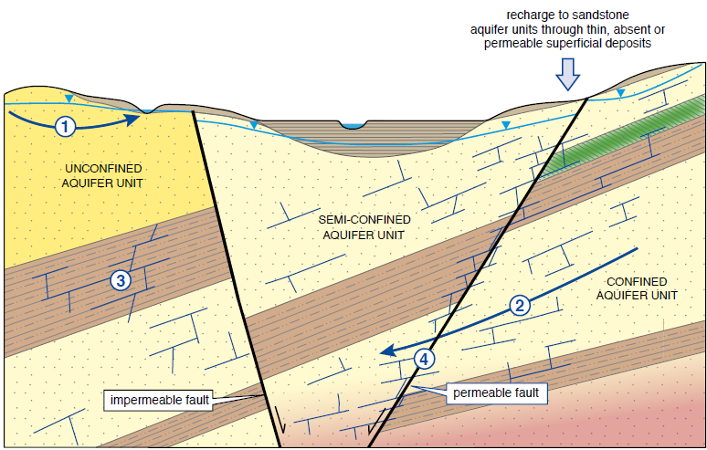
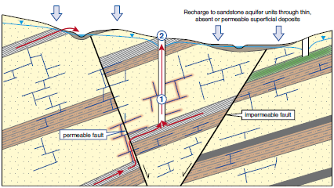
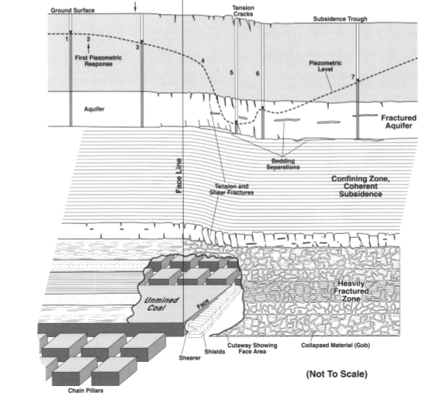
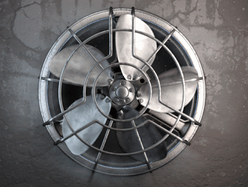
RQ2 - what is the footprint of past mining activities on the thermal state and temperature distribution in mines?
Introduction
Chapter 2
Chapter 3
Chapter 1
Methods
Conclusion
I) Before mining
II) During mining
III) After mining
Booth et al. (2000)
O Dochartaigh (2015)
↗K, ↗Ф
What is the rock temperature?
Where does the water come from?
Notes:
Questions:
Does the temperature gradient in mines re-equilibrate with the undisturbed regional gradient?
What is the extent of the perturbations caused by water advection in large mining voids on heat distribution in mines?
Is the temperature profile in shafts representative (during flooding/pumping)?
Chapter 2 will therefore aim at understanding:
What is the initial temperature distribution within the mines ?
Through H1: mine workings could be modelled as sink/source of heat, depending on the source of water and natural head gradien
We expect that the initial temperature in mines depends on « leaks between tunnels and regional hydrology »
A challenge is to define the right boundary conditions, hence H2

Slide 11
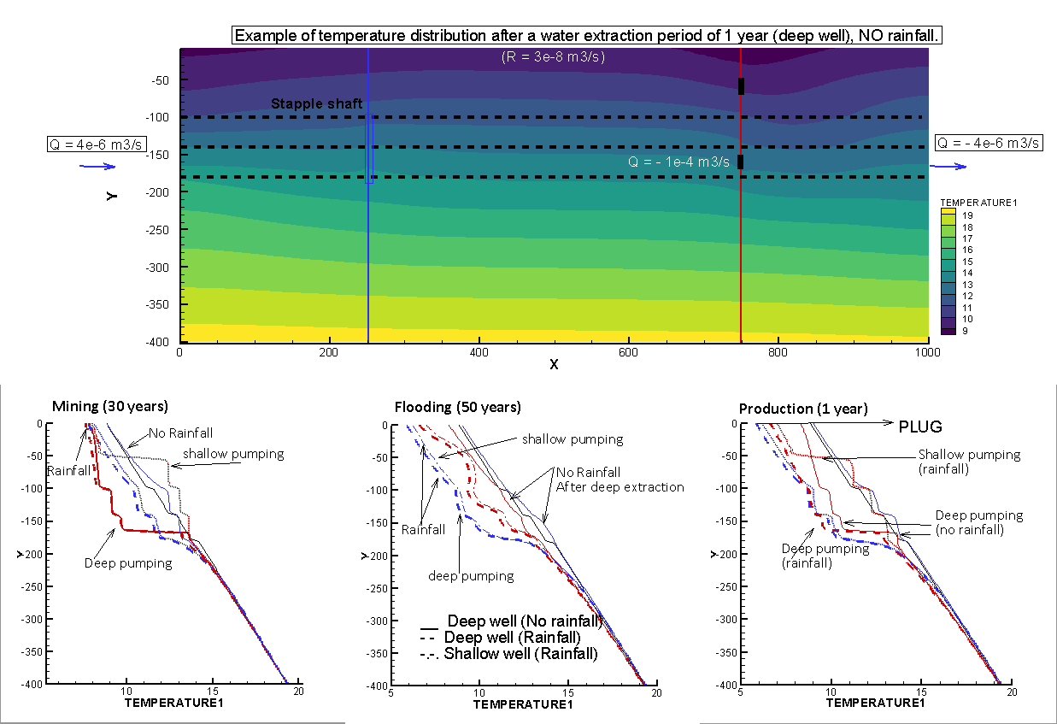
Initial results
Introduction
Chapter 2
Chapter 3
Chapter 1
Methods
Conclusion
H0 – Estimate the time required for temperature profile return to equilibrium.
Methods:
2D models Diffusion-Advection
Pumping / Recovery
Effect of boundary conditions
Notes:
mining has fundamentally altered the thermal state of the shallow crust away from its natural form, the present thermal state reflecting changes since the modification took place and retaining no ‘memory’ of the former thermal state before mining began
Watson and Westaway 2020
Constant head on the right: for coastal scenario
PLUG: wells are plugged/cemented after mining period → want to avoid fast rainfall recharge during heat/water recovery and production

Slide 12
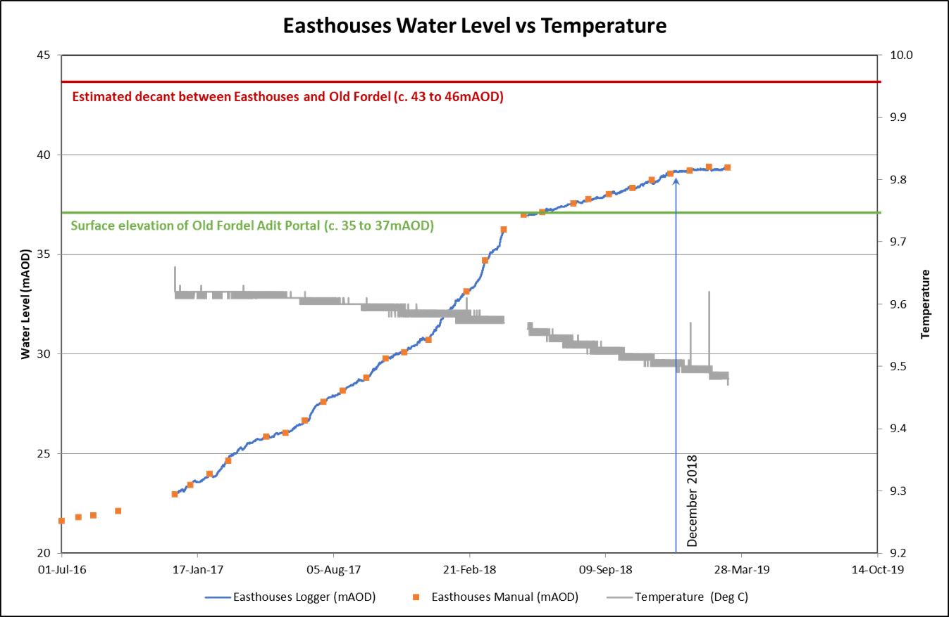
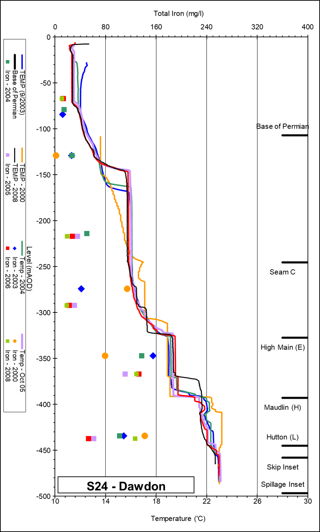
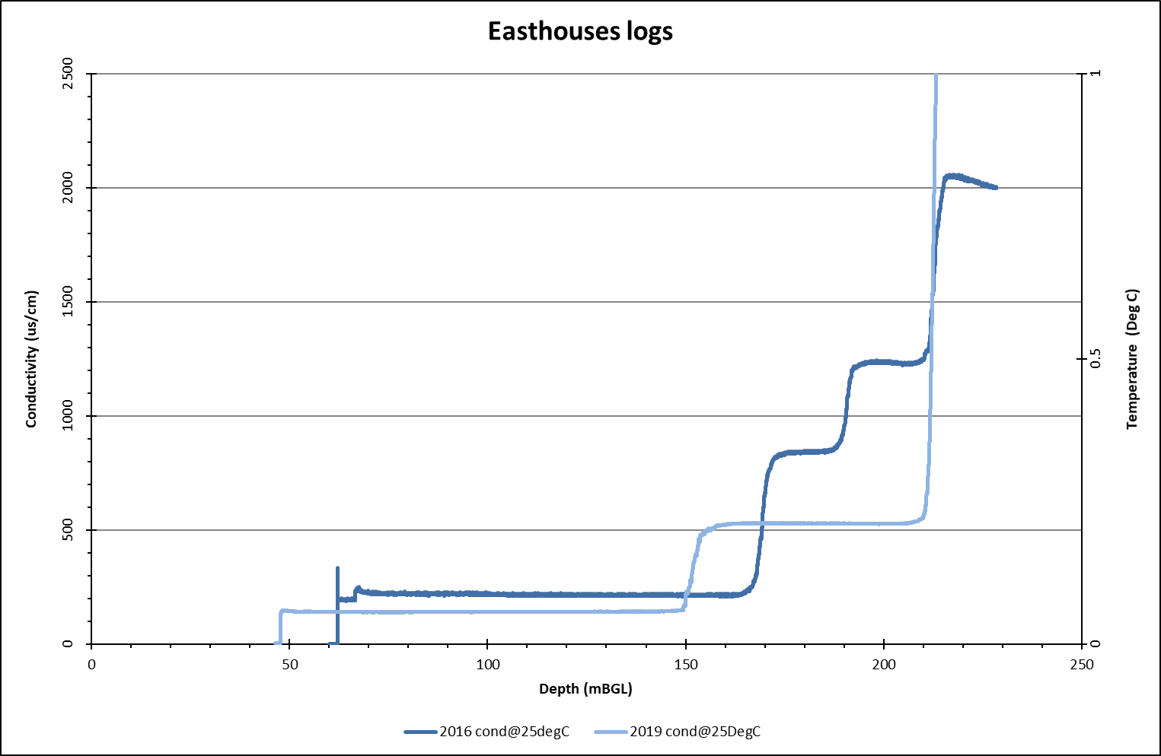
Model Calibration & verification
Introduction
Chapter 2
Chapter 3
Chapter 1
Methods
Conclusion
H1 – Model temperature profiles in shafts to constrain boundary conditions of models.
Based on existing data:
Bilston Glen (Scotland)
Dawdon (NE-England)
Output:
Quantify initial mine vs undisturbed heat content for different scenarios
Notes:
Calibration and validation of model using existing data from Bilston Glen in Scotland - Dawdon in NE England by simulation of flooding / temperature recovery
→ Enough data and two different geometries (dipping layer / syncline)
Data types to fit: T-EC profiles and time series (water level, temperature), geochemistry (deep water in Dawdon = Chloride anion dominant = long residence time / Shallow water in Bilston Glen (Bicarbonate dominant) according to Chebotarev chart
Based on calibrated model, evaluation of the recharge rate / heat recovery rate of mine water.
→ How long can it be sustained? what is the footprint area for providing heat for domestic heating?

Slide 13
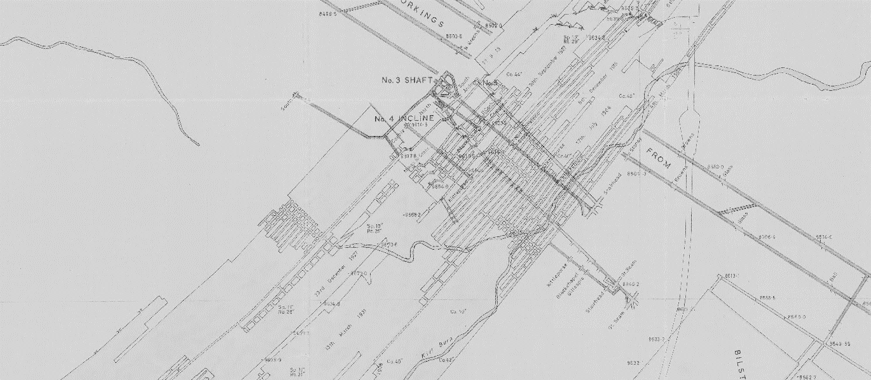
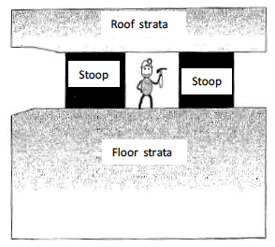
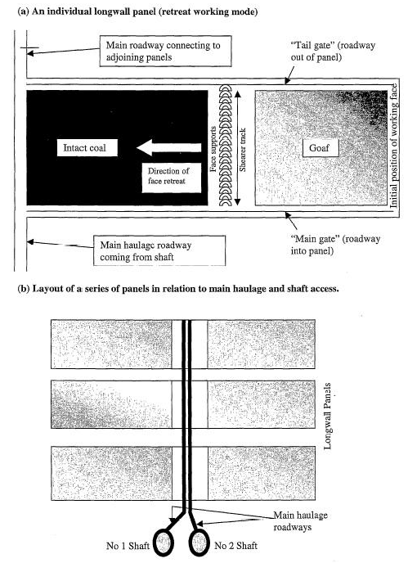
RQ3 - What are the key mine features allowing to assess the sustainable heat potential of coal mines at the scale of a mine?
Introduction
Chapter 2
Chapter 3
Chapter 1
Methods
Conclusion
Objectives:
Develop a methodology to use available GIS shapefiles
Define the level of details necessary to build representative models.
Assess if 2D models can be as good as 3D models.
Pillar & Stall Longwall
Hypothesis
H0 - The voids geometry does not impact the heat exchange rate
H2 - The lateral extent, V, T and interconnectivity of the roadways is a key control on the heat capacity/recharge rate.
H1 – An "equivalent porosity" and "equivalent heat capacity" parameter can be defined to scale up 3D properties / processes in vertical 2D models.
Notes:
How can we simplify mine plans to build representative models ?
Mine plans are complex. A certain level of simplification is necessary. To what extent can we simplify it and what features are really important?
Hypothesis: The interconnectivity of the roadway network affect the total accessible volume of rock and then the amplitude/direction of fluxes induced during production, hence the overall heat exchange rate and heat depletion rate.
Evaluate the footprint area of heat extraction
What is the geothermal potential of mines?
Can a sustainable heat extraction rate be maintained?
¹ direction/amplitude of induced fluxes during production/recovery

Slide 14
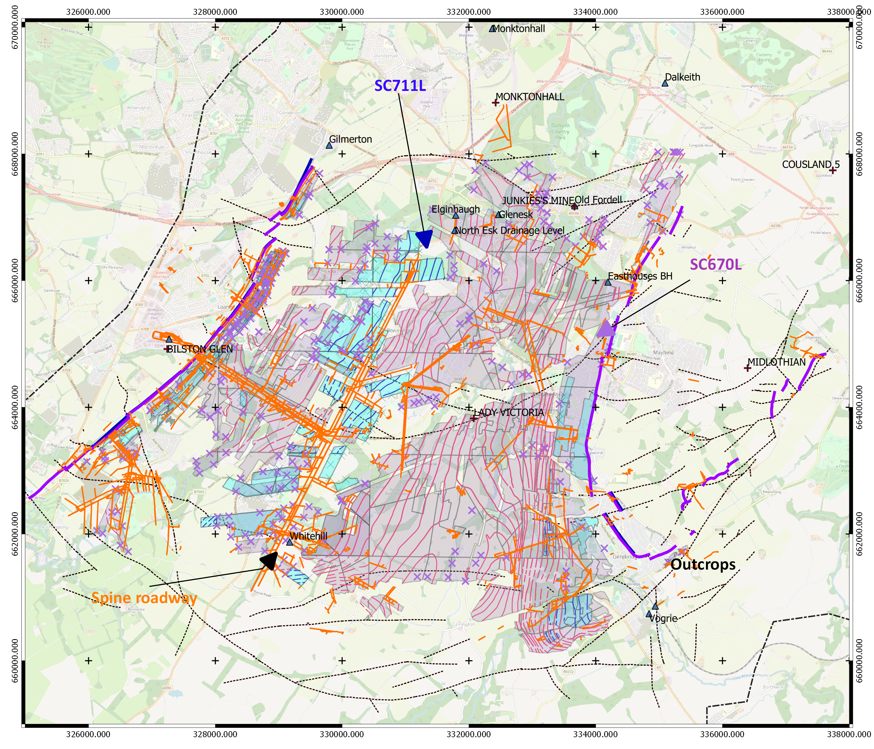
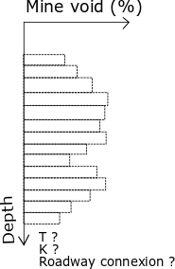
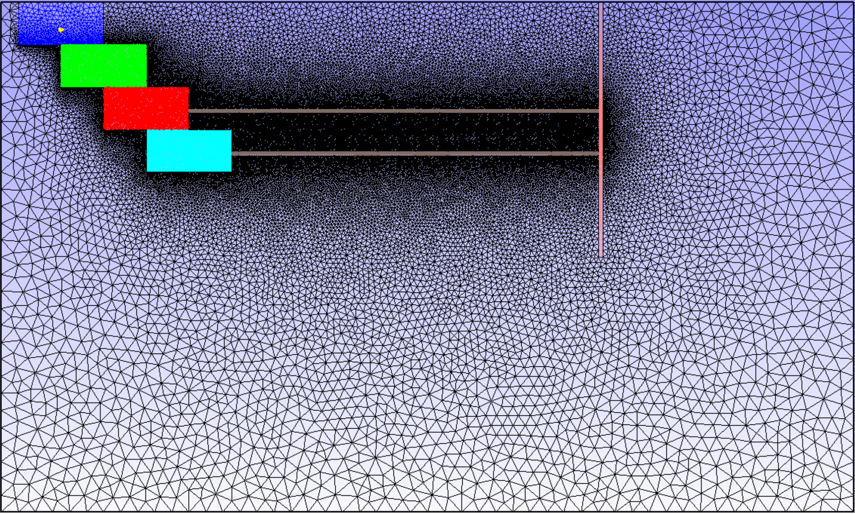
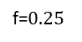
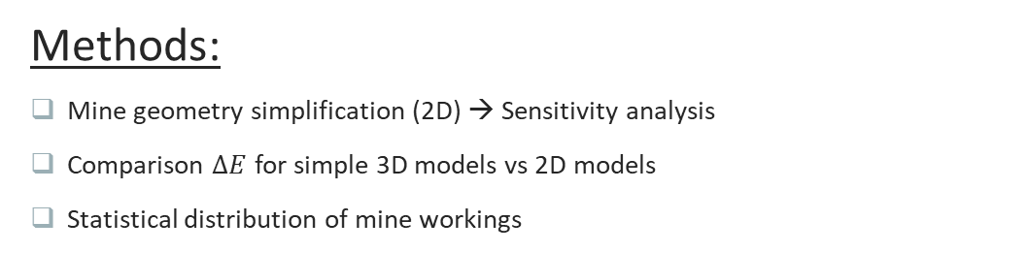
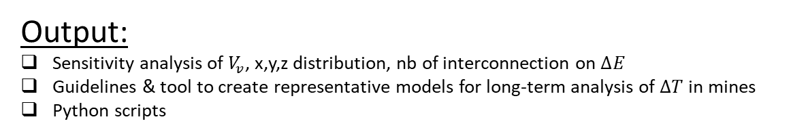
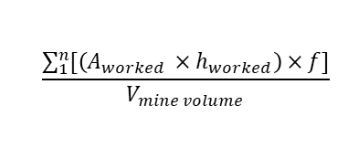
Proposed approach
Introduction
Chapter 2
Chapter 3
Chapter 1
Methods
Conclusion
Methods:
Mine geometry simplification (2D) → Sensitivity analysis
Comparison $∆E$ for simple 3D models vs 2D models
Statistical distribution of mine workings
$$\frac{\sum_{1}^{n}{[\left(A_{worked} ×h_{worked}\right)}×f]}{V_{mine volume}}$$
f=$0.25$
→ Fit temperature time-series / profiles ?
Output:
Sensitivity analysis of $V_{v}$, x,y,z distribution, nb of interconnection on $∆E$
Guidelines & tool to create representative models for long-term analysis of $∆T$ in mines
Python scripts
Notes:
A series of model will be created through the development of a methodology to generate a representative statistical distribution of mine working network / roadways.
Calibration and validation of model using existing data.
How to verify equivalent parameters?

Slide 15
Expected outcome
Introduction
Chapter 2
Chapter 3
Chapter 1
Methods
Conclusion
Year 1
Year2
Year3
Conceptual modeling
Heat extraction model
Post-mining heat distribution in mines
Geometrical analysis
Geothermal potential evaluation
Advective/diffusive transport
Spatial analysis of temperature distribution in the UK
Case study
RQ1 - What are the main control on mine-water temperature?
RQ2 - What is the initial heat capacity of flooded mines?
RQ3 - What are the key geometrical elements?
Development of an analytical/numerical tool
Assess footprint area of heat extraction
Guide licensing of heat
Notes:
Comparison between mine geometries, measurements types, the local geology and temperature at different mines will be cross correlated with results from models to answer the question: Why different mines have different temperatures ?
Heat transfers does’t have a clear boundary
Aim:
Need to guide the licensing of heat through the development a predictive tool for the Coal authority.
inform policymaking for minewater scheme development
Fine discretisation of coal beds might be required to produce accurate results → negative implications for your hypothesis regarding the generic modelling of mine structures?
Show how to address any uncertainties in results:
sensitivity testings → how quantify this uncertainty? → Graphs of i.e. production temperature vs inflow temperature for i.e. different perability contrasts
Use dimensionless parameters
Ideally: if analytical solution can be developed (as a function of flow path length, inflow temperature, rock temperature..), create code that uses Bayesian inversion to create probability distribution of the expected water temperature at t=30 years depending on the considered uncertain parameters,

Slide 16
REFERENCES
Adams, C., Monaghan, A., Gluyas, J., 2019. Mining for Heat. In: WWW.GEOLSOC.ORG.UK/GEOSCIENTIST
Burley, A., Edmunds M., W., and Gale, I. (1984). Catalogue of geothermal data for the land area of the United Kingdom. Second revision. British Geological Survey
Ghoreishi-Madiseh, S. A., Ghomshei, M. M., Hassani, F. P., and Abbasy, F. (2012). Sustainable heat extraction from abandoned mine tunnels: A numerical model. J. Renewable Sustainable Energy, p. 17.
Gillespie, M., Crane, E., and Barron, H. (2013). Study into the Potential for Deep Geothermal Energy in Scotland - Volume 2. AEC/001/11. Scottish Government, p. 129.
Guo, P., He, M., Zheng, L., and Zhang, N. (2017). A geothermal recycling system for cooling and heating in
deep mines. Applied Thermal Engineering [online]. 116, pp. 833–839. ISSN: 13594311. DOI: 10.1016/j. applthermaleng.2017.01.116
Hamm, V., Bazargan Sabet, B. 2010. Modelling of fluid flow and heat transfer to assess the geothermal potential of a flooded coal mine in Lorraine, France. Geothermics, 39.2, p. 177-186. doi.org/10.1016/j.geothermics.2010.03.004.
O Dochartaigh, B., Macdonald, A., Fitzsimons, V., and Ward, R. (2015). Scotland’s aquifers and groundwater
bodies. Geological Survey Open Report OR/15/028. British Geological Survey, p. 76.
Raymond, J. and Therrien, R. (2008). Low-temperature geothermal potential of the flooded Gaspé Mines, Québec, Canada. Geothermics. 37.2, pp. 189–210. DOI: 10.1016/j.geothermics.2007.10.001.
Todd, F., McDermott, C., Harris, A. F., Bond, A., and Gilfillan, S. (2019). Coupled hydraulic and mechanical model of surface uplift due to mine water rebound: implications for mine water heating and cooling schemes. Scottish Journal of Geology [online], sjg2018–028. ISSN: 0036-9276, 2041-4951. DOI: 10.1144/sjg2018-028.

Slide 17
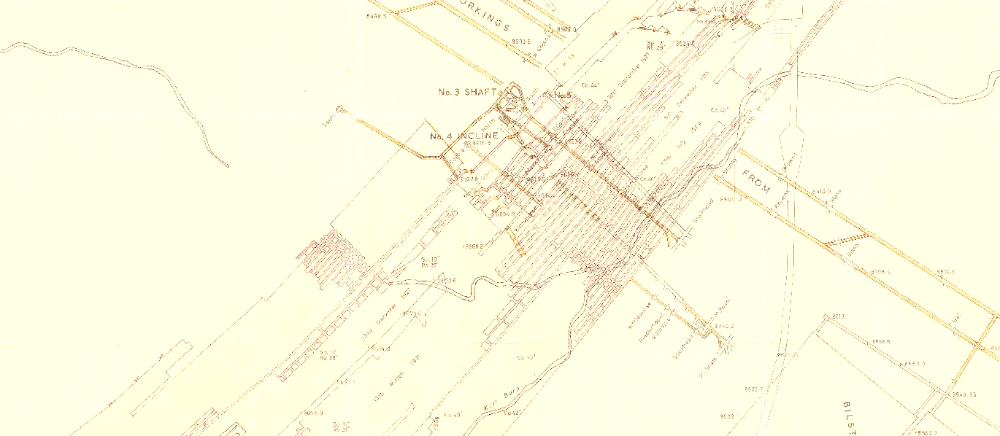
Questions ?
H1.0: Solar recharge initially higher if gradient not at steady state + increases with heat extraction
H1.1: High permeability contrasts tends to favor heat advection during production
H2.0: There is a permanent perturbations of geothermal gradient due to mining activities
H2.2: Vertical distribution of mined seams impact the overall temperature change within the system
Next:
Analytical solution for lateral advective flux using realistic heat extraction rate (2D model)
i.e. dispersion of thermal plume in porous aquifer
3D model for heat extraction
Preliminary analysis of temperature data from the CA
Processing of GIS data to import them in GMSH

Slide 18
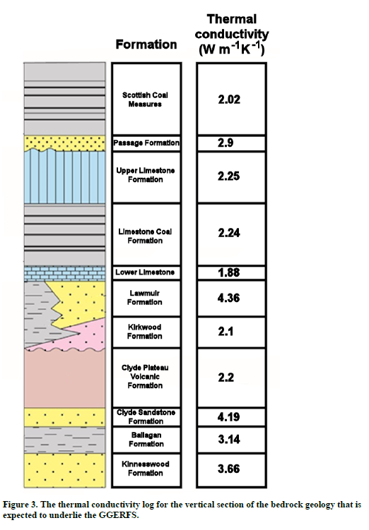
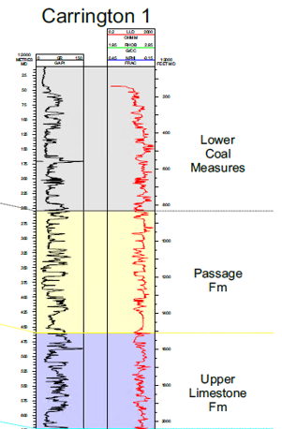
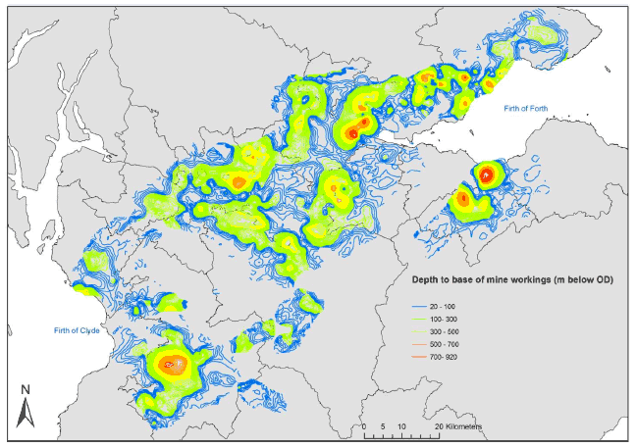
Back Up

Slide 19
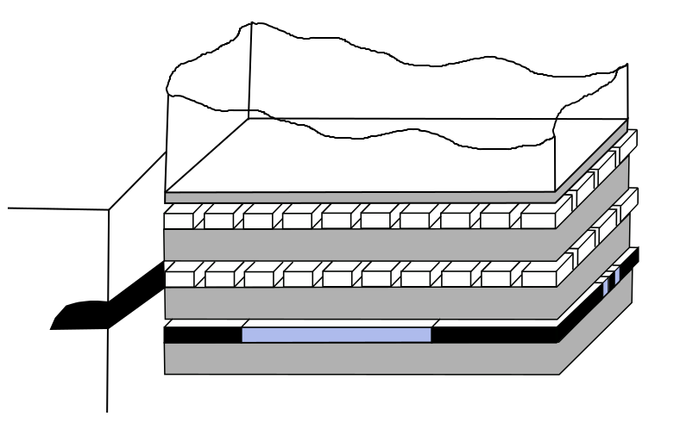

Back Up
Mine structure
Underground workings:
Pillar and stall
Longwall mining
Main pathways :
Shafts
Roadways
Layout of stoop and room mine workings (top) and longwall mining (bottom). From Younger and Adams, 1999.

Slide 20
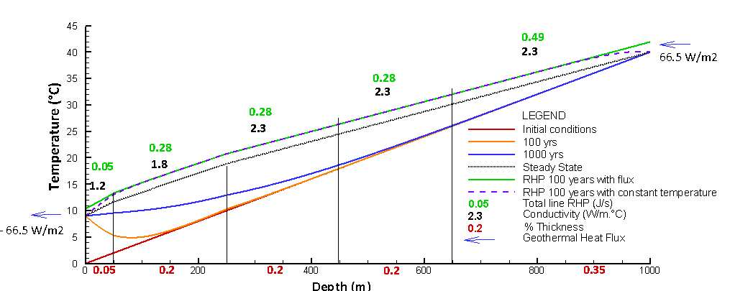


Initial Results
Introduction
Chapter 2
Chapter 3
Chapter 1
Methods
Conclusion
Contribution from RHP

Slide 21



NUMERICAL APPROACH
Introduction
Chapter 2
Chapter 3
Chapter 1
Methods
Conclusion
H0 – Solar heat recharge is negligible relative to the geothermal heat flux.
Watson & Westaway, 2020
Westaway and Younger, 2016
Westaway and Younger, 2013

Slide 22

NUMERICAL APPROACH
Introduction
Chapter 2
Chapter 3
Chapter 1
Methods
Conclusion
Vertical conductive flux
H0 – Solar heat recharge is negligible relative to the geothermal heat flux.
1) What is ∆q ?
-1000W
Notes:
Need to speak in terms of flux
Most of previous studies considered fixed temperature at top BC but not correct for shallow systems
Sensitivity analysis on geometrical, technical or numerical parameters

Slide 23





NUMERICAL APPROACH
Introduction
Chapter 2
Chapter 3
Chapter 1
Methods
Conclusion
H0 – Solar heat recharge is negligible relative to the geothermal heat flux.
$q_{g}$= 0.092
$q_{s}$= 0.092 - 0.012 = 0.08 allowed to come in
If cooling of 5°C allowed (70m2 area for 1 year):
Total heat recharge from surface (-0.012)
=> 0.079 x 70 = 6 W
Total heat recharge from below
=> 0.092 x 70 = 7 W
Lateral heat flux = 0.80 W/m2
If area = 2200 m² (calculated for $∆T=5°C)$
→ Overestimation as vertical fluxes are induced

Slide 24


NEXT STEP
Introduction
Chapter 2
Chapter 3
Chapter 1
Methods
Conclusion
H0 – Solar heat recharge is negligible relative to the geothermal heat flux.
Notes:
Need to speak in terms of flux
Most of previous studies considered fixed temperature at top BC but not correct for shallow systems
Sensitivity analysis on geometrical, technical or numerical parameters

Slide 25












ANALYTICAL VS Numerical APPROACH
Introduction
Chapter 2
Chapter 3
Chapter 1
Methods
Conclusion
Find $W_{f}$ the volumetric flow rate (m3/s)
$$E_{HP}=1000 W$$
with $∆T_{w} =5°C$ across the heat exchanger
$$Q_{f}=∆TρcW_{f}$$
$W_{f}=170$ L/s
$$ρ_{w}=1000$$
$$c_{w}=4680$$
$$ρ=2500$$
$c$= 950
Find$∆T_{r}$ or Vr required (no recharge)
If no GW adevction:
$$E_{r}=E_{r}$$
$$E_{r}=∆T_{r}ρcV(1−φ)$$
$E_{w}=∆T_{w}ρ_{w}c_{w}$ $W_{f}$t
$T_{r}=T_{r0}−\frac{∆T_{w}ρ_{w}c_{w}W_{f}}{ρcV(1−φ) }$t
If GW adevction:
Delayed / Faster dispersion in thermal plume
If $V=1000 ×1000×100 m^{3}$
$∆T_{r}=−21°C$ for t = 30 years
If $∆T_{r,max}=5 °C$
$V=\frac{ρ_{w}c_{w}}{ρc}×\frac{W_{f}}{(1−φ)}$t $=4×{10}^{8}m^{3}$ = 2km x 2km x 100m
Notes:
how much flow is required to supply the necessary heat?
→ preliminary conclusion as to whether that flow rate is realistic for naturally occurring groundwater conditions.

Slide 26





Past Modelling approaches
Introduction
Chapter 2
Chapter 3
Chapter 1
Methods
Conclusion
Mine geometry
Roof k
$$T_{inj}, Q$$
Equivalent porous media for mine workings
Density effects
λ, k, V
Mine tunnels
(Ghoreishi Madeish et al., 2012)
Dual porosity medium
(Guo et al., 2018)
3D model of shaft/roadway connections
(Hamm et al., 2010)
Combined 3D porous medium and 1D pipe flow
(Raymond and Therrien, 2008)
Notes:
Modeling of mines done before
Both generic cases and specific case study
Both for tunnels / workings systems
Raymond and Therrien: quite complex and global modelling approach
Difficulty in mine systems (which differs from usual aquifers) is the necessity to solve for water, heat and mass transport in a system composed of a porous media (Darcy flow) and open void (pipe flow) that can lead to numerical instability. Has been overcome by combining 1D, 2D and 3D elements
But don’t evaluate the contribution of each parameter (assume all heat comes from heat flux)

Slide 27


















Temperature profiles during mining

Slide 28


Temperature profiles during production
Q=4.0e-6
H=0

Slide 29


Proposed approach
Introduction
Chapter 2
Chapter 3
Chapter 1
Methods
Conclusion
H2 - The lateral extent, volume and interconnectivity of the roadway network is a key control on the overall heat capacity of the mine (i.e. heat depletion rate).
Notes:
What is the time necessary for water to heat up and what is the geothermal potential of mines?
Based on calibrated model, evaluation of the recharge rate / heat recovery rate of mine water. How long can it be sustained? what is the footprint area for providing heat for domestic heating?

Slide 30
BACKUP
Introduction
Chapter 2
Chapter 3
Chapter 1
Methods
Conclusion
Notes:
What is the time necessary for water to heat up and what is the geothermal potential of mines?
Based on calibrated model, evaluation of the recharge rate / heat recovery rate of mine water. How long can it be sustained? what is the footprint area for providing heat for domestic heating?

